Slide 1
An Analysis on Employee Retention and Attrition Rates by various factors in the Healthcare Sector Database in the US
Team Members:
Jane Enkhbaatar
Payal Dhillon (Alisha)
Geon Woo Jeong Andy
Oseremhen Okpamen

Slide 2
Project Goal:
Analyze employee retention and attrition rates by various factors based on the healthcare sector database in the US.
Resources:
Kaggle.com (Employee Attrition for Healthcare | Kaggle)
Limitation:
Sample Size = 1676 (Research questions are answered by sample dataset from 3,000 Hospital across the USA).
Sample Profile (IBM Watson Dataset only).
Data Collection (Kaggle Employee Attrition for Healthcare - dataset).
Analysis (Note Healthcare experts, Analysis are done only based on dataset).

Slide 3
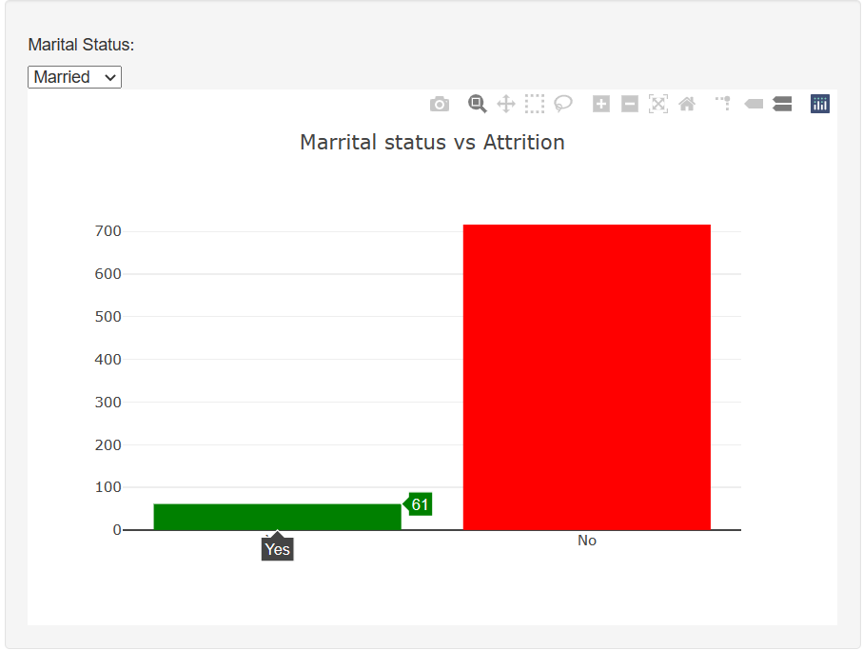
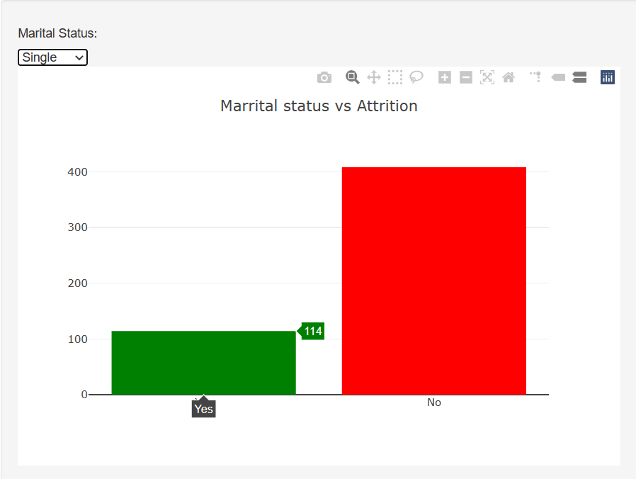
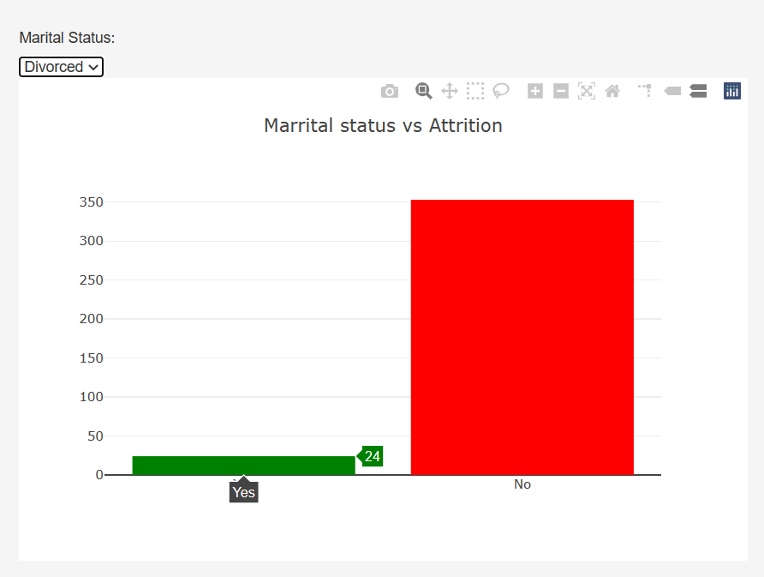
Marital Status vs Attrition:
Single people’s retention rate was lower compared to Married and Divorced people’s retention rate.
Married and Divorced people’s attrition rate is relatively similar.
7.8% of Married employees left the job and 92% were retained
21.8% of Single employees left the job and 78.1% were retained
6.3% of Divorced employees left the job and 93% were retained.

Slide 4
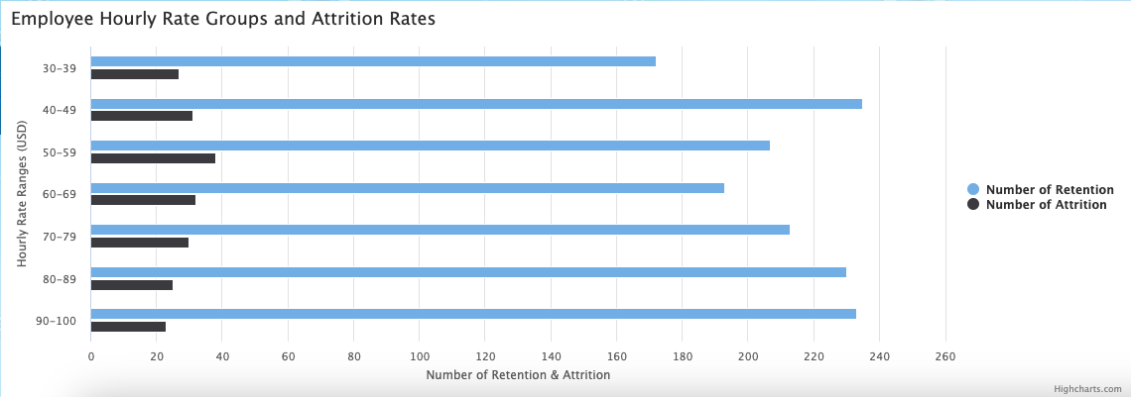
Hourly Rate (USD) vs Attrition:
The numbers of employees who stayed at their jobs vs. who quit. The least number of attrition happened in the highest pay range ($90-$100), but surprisingly, the most number of people who quit was not in the lowest pay range. Although the high percentage of retention in the highest pay range was easily predicted, the lower ranges did not show expected correlation with attrition rates.

Slide 5
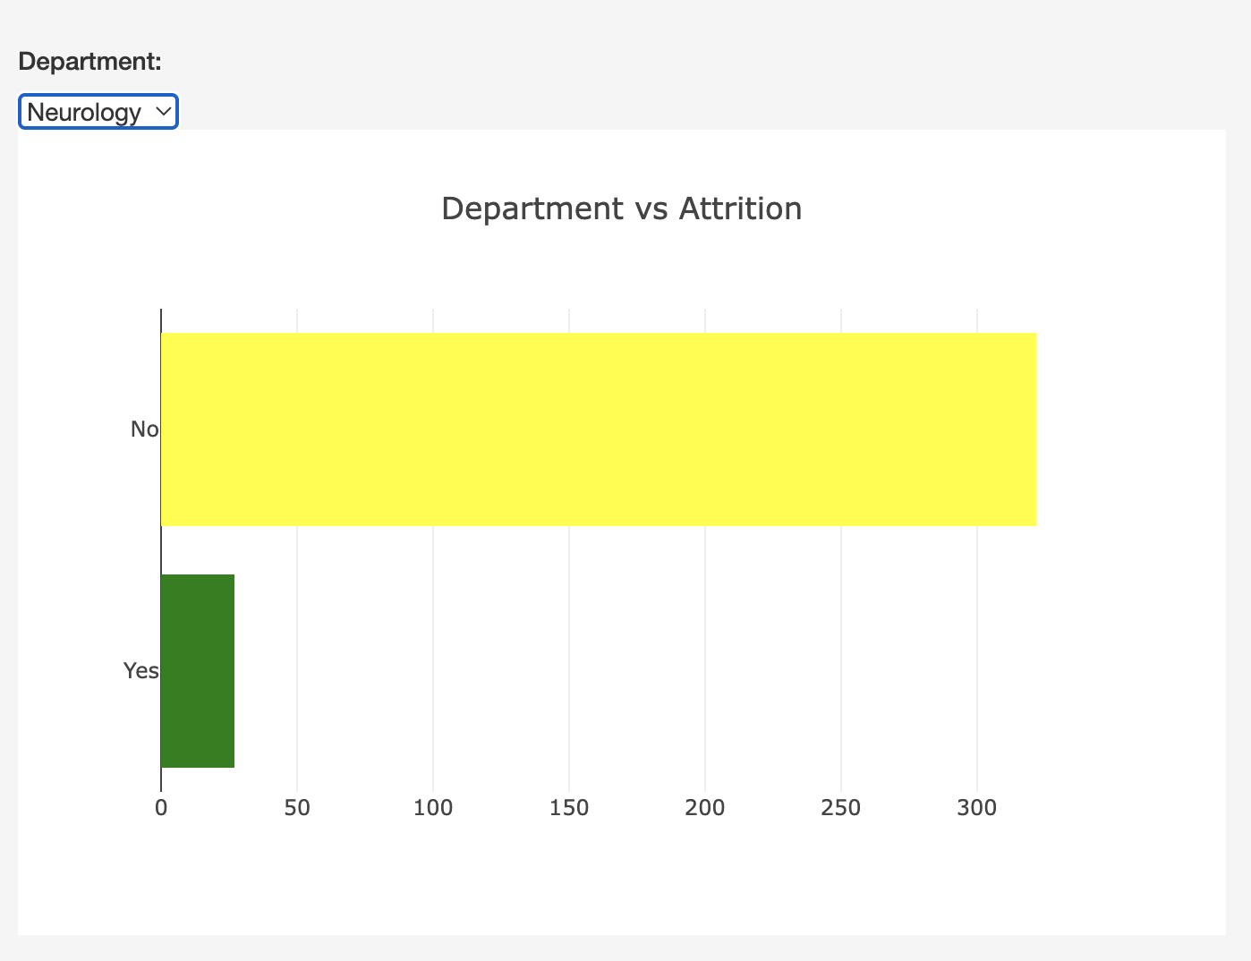
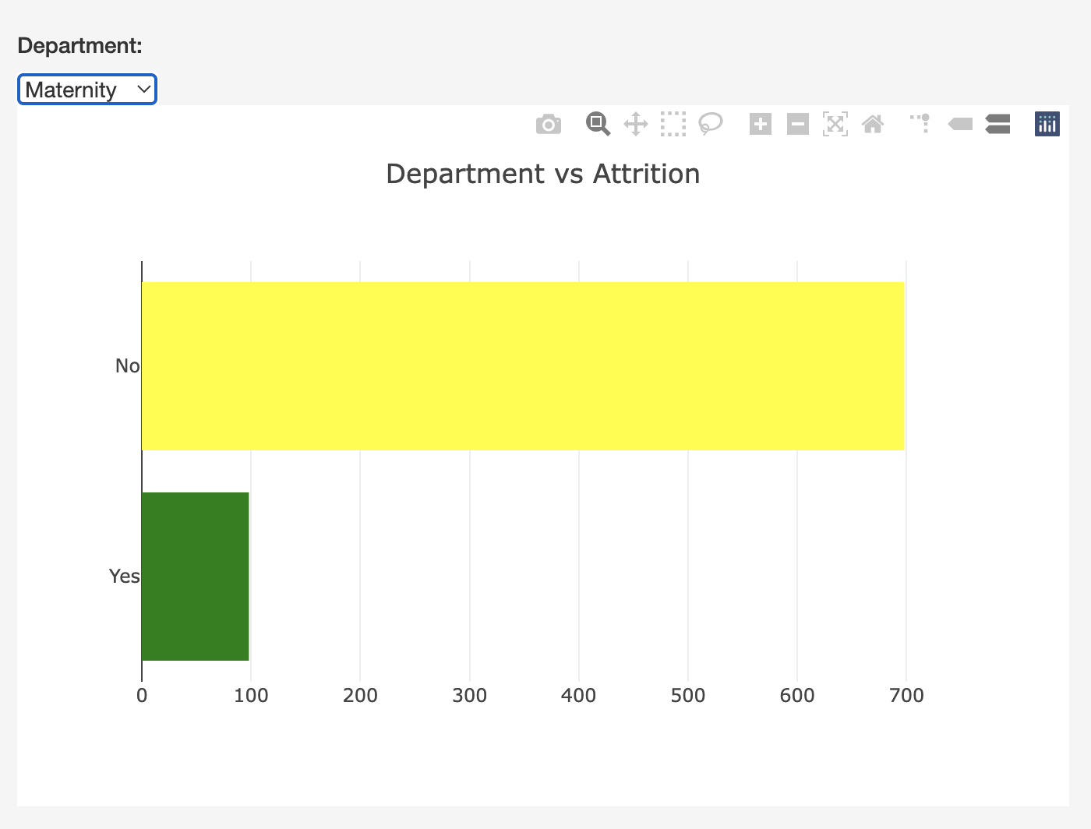
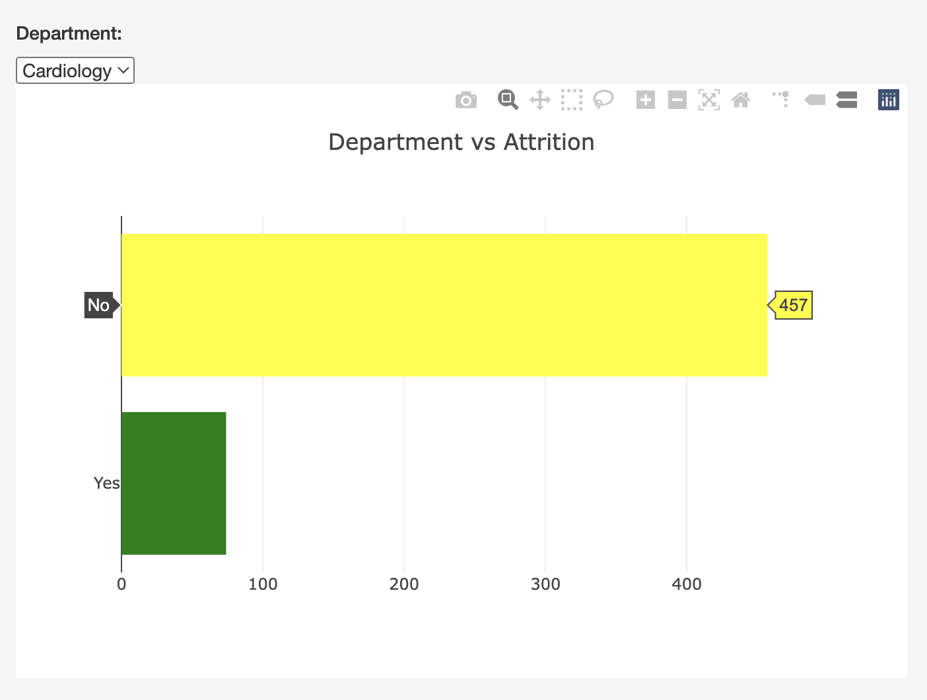
Department vs Attrition:
Neurology Department:
The neurology department had the least number of employees in the dataset. The department recorded the lowest number of attrition at 7.7%
Cardiology Department:
The cardiology department recorded about 13.9% of their employees leave.
Maternity Department:
Maternity department has the highest number of employees leaving their jobs but also had the most number of employees in the dataset. The department recorded 12.3% attrition.
Notes:
Link back to dashboard for accurate numbers.

Slide 6
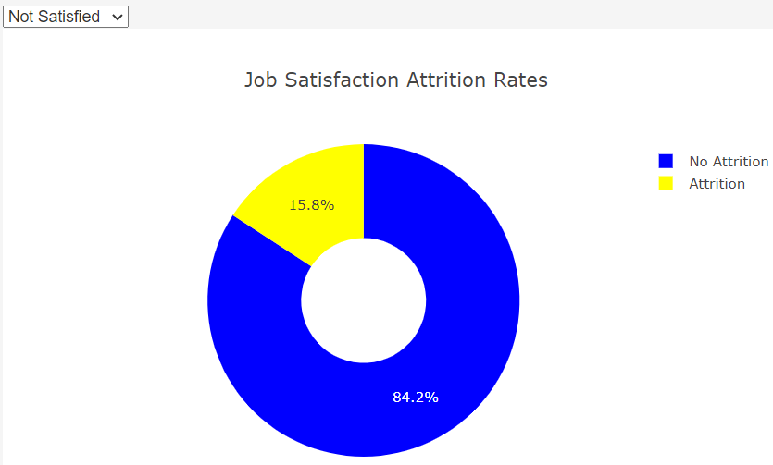
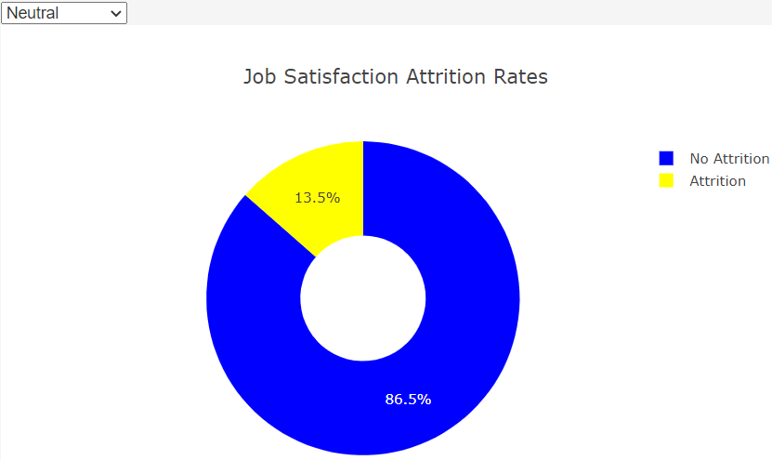
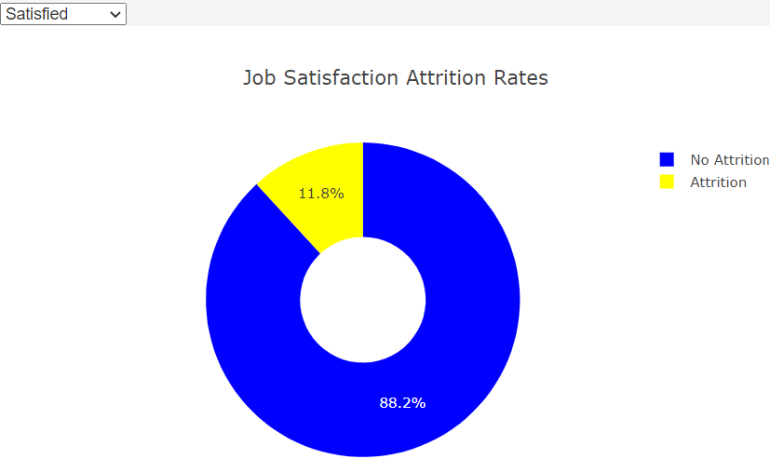
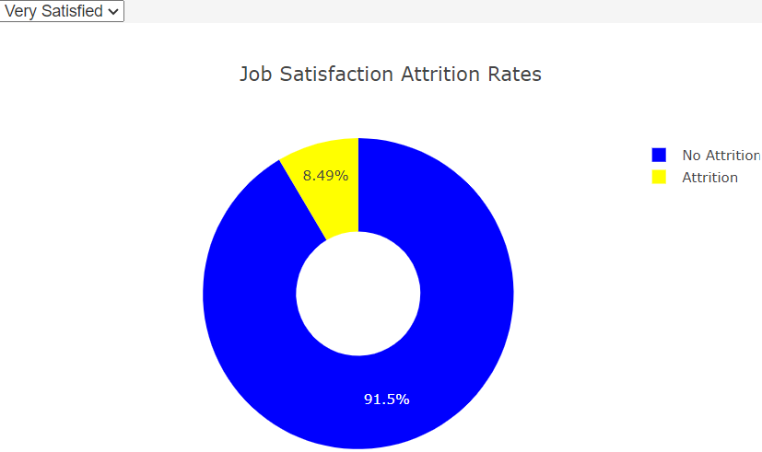
Job Satisfaction vs Attrition:
Based on the database, it has shown that 15.5% employees that were Unsatisfied with their job, were more likely to leave their employer compared to the the employees which were satisfied with their job.
Which is approximately 4-7% more compared to the employees who are satisfied with their job.
Employees that did not want to give an input about their job satisfaction based on the chart you can see they also had the 2nd highest percentage of leaving their job.

Slide 7
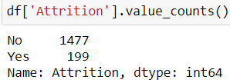
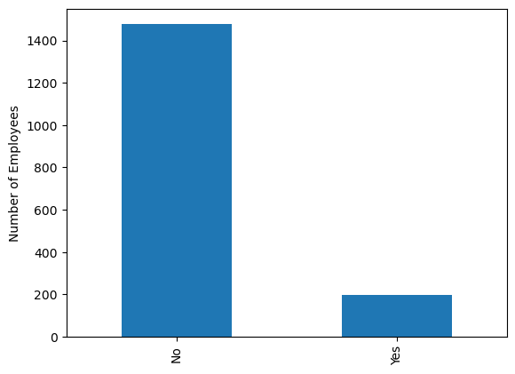
Job Satisfaction vs Attrition:
Total Number of Attrition
Combining all 4 surveys about employees being satisfied or not being satisfied, the database shows that about 199 employees have left their jobs, which makes up to 11.8% of the American Healthcare sector from the years of 2020-2022, to leave their place of employment despite being satisfied, not satisfied, or neutral.
Notes:
Total of employees: 1676

Slide 8
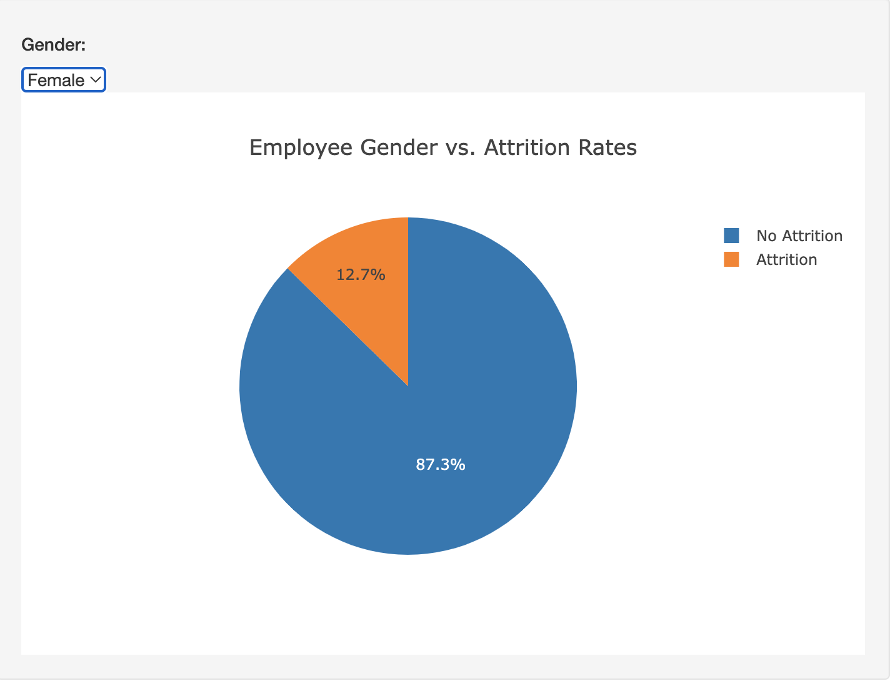
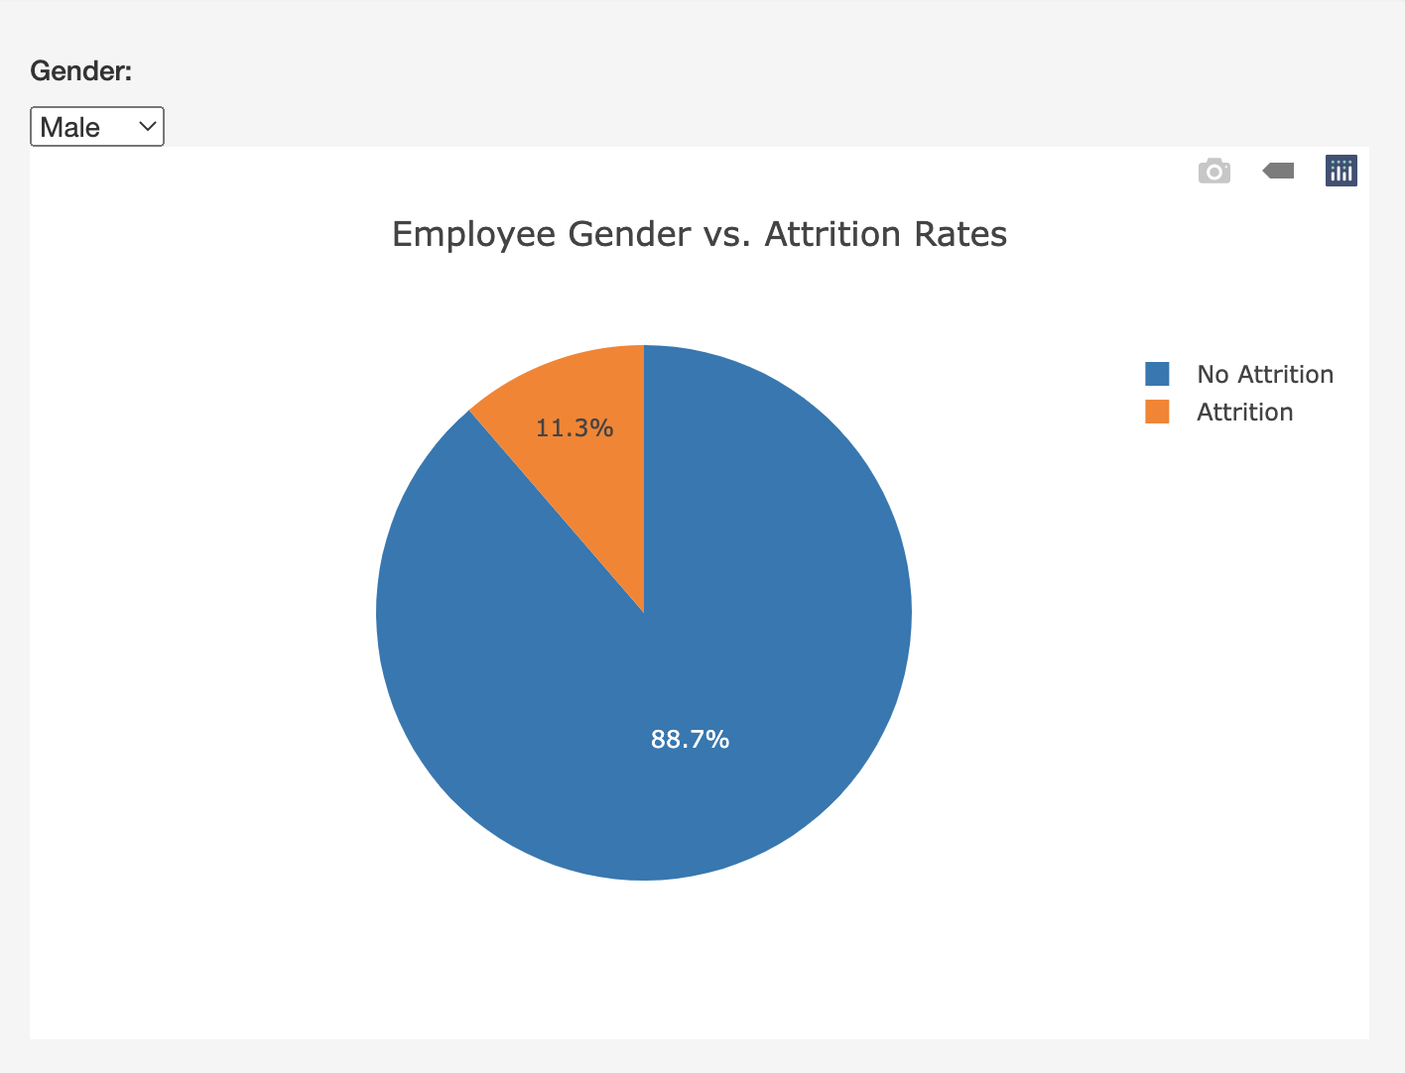
Gender vs Attrition:
Female attrition rate is slightly higher (1.4%), but as there is a higher number of male employees (998, of which 113 quit) than female employees (678, of which 86 quit).
This data is insufficient in providing proof that gender differences contribute to attrition.

Slide 9
Conclusion:
Data is insufficient; direct correlations of the analyzed factors with attrition rates are difficult to find.
It is assumed that all of the analyzed factors are not direct nor definite indicators of attrition. Attrition, namely job quitting, particularly but not limited to the healthcare sector in the U.S., cannot be predetermined by any one factor of employees; attrition is a result of various combinations of such factors, in addition to many other instances and experiences in the personal level.

Slide 10

Thank You!

